Slide 1
Empirically Relating Complexity-theoretic Parameters with
SAT Solver Performance
Ed Zulkoski¹, Ruben Martins², Christoph M. Wintersteiger³, Robert
Robere⁴, Jia Liang¹, Krzysztof Czarnecki¹, and Vijay Ganesh¹
Pragmatics of Constraint Reasoning
August 28, 2017
¹ University of Waterloo
² University of Texas at Austin (now at CMU)
³ Microsoft Research, Cambridge
⁴ University of Toronto

Slide 2
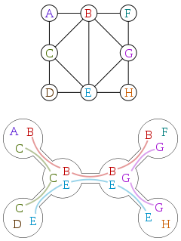
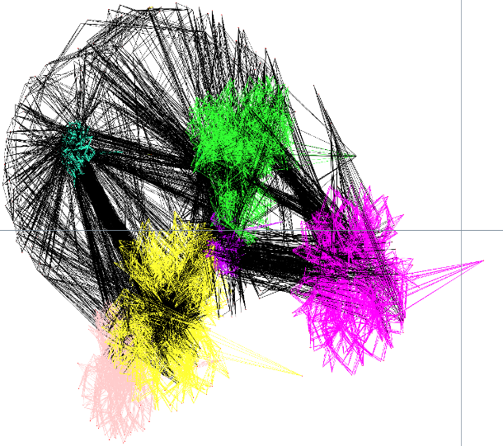
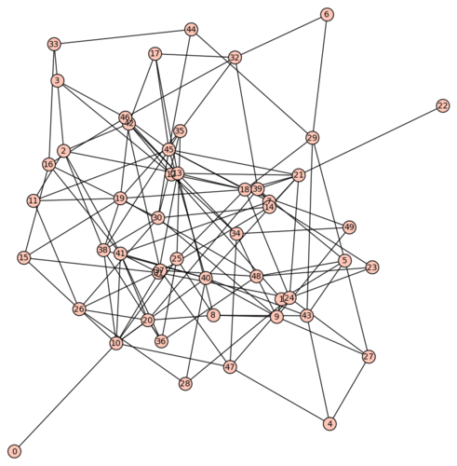
Many proposed SAT-hardness metrics…
Treewidth Community Structure Backdoors
Which metrics have the best explanatory power, across a wide variety of benchmarks?

Slide 3
A brief look at the literature
 | Sat Competitions | 3SAT | Planning | Feature Models | Graph Coloring | Automobile Config.
Cmty. Str. | [CA12][ZN14] | [CA12]
Treewidth | [RM11] |  |  | [RP13]
Backbones | [MJ15] | [PK05] |  |  | [PK05]
BD Keys |  |  | [YR09] |  | [YR09]
Weak BD | [ZL11] | [PK05] | [RW03] |  | [PK05]
Strong BD |  | [PK05]
Learning BD |  |  | [BD09]
Tree BD |  | [MS08] |  |  |  | [MS08]

Slide 4
Outline
Background on SAT formula parameters/measures
Correlating SAT measures with CDCL solving time
Using measures as a lens to understand solver performance
Conclusions

Slide 5
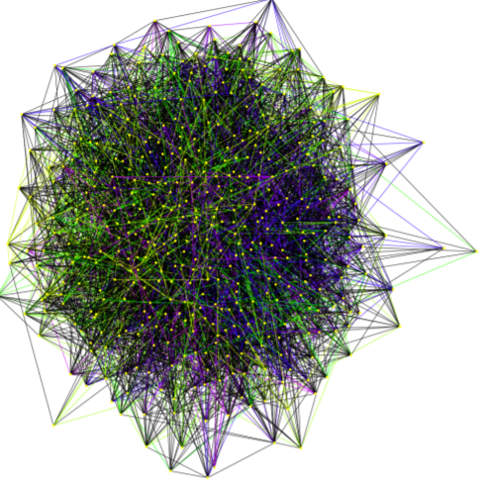
Community Structure
Vertex for every variable
Edge between any two vertices that share a clause
Goal: partition the vertices into dense communities that are sparsely interconnected
Modularity – measure of goodness of community structure [0, 1]

Slide 6
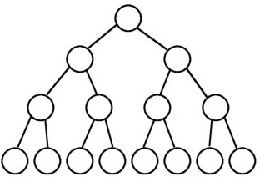


Weak Backdoors
A subsolver is a “polynomial-time incomplete SAT solver” (BCP)
A weak backdoor w.r.t. a subsolver $C$is a nonempty set $B⊆vars(F)$, if for some assignment $a_{B}$, $C\left(F\left[a_{B}\right]\right)→⊤$
  If we get the right assignment to $B$, the problem is polynomial-time
variables in B
all full assignments to B
Try to apply BCP to all full assignments to B
BCP must return $⊤$ for *at least* one assignment

Slide 7




LSR-backdoors
Motivation – clause learning and restarts are a pivotal aspect of SAT solving
LSR = Learning sensitive+restarts
  Intuitive definition: CDCL which can only
  branch on backdoor variables
  Computing an LSR-backdoor upper bound is relatively simple
Trivial LSR-backdoor – all decision variables
  We minimize this set of variables for experiments
$$C_{1}$$
$$C_{3}$$
$$C_{2}$$
variables in B
1 2 3 4 5 6 7 8
all full assignments to B
$$F\left[a_{8}\right]⊢_{BCP}Unknown$$
$$F\left[a_{8}\right], C_{1},…, C_{7}⊢_{BCP}⊥$$

Slide 8
Other Measures
Backbones – the set of variables such that, for every satisfying assignment to the formula, the variable’s assignment is the same
Treewidth (TW) – measures how “tree-like” the graphical abstraction of the formula appears
  Actual trees have treewidth 1

Slide 9
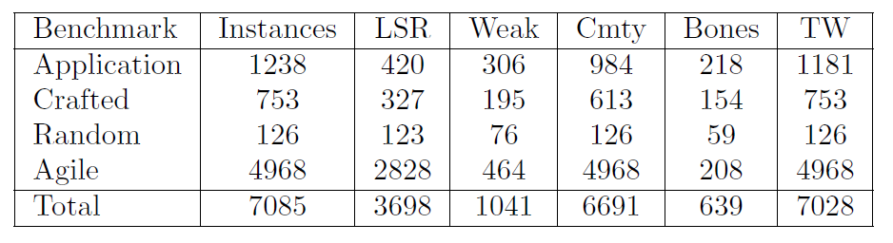
Experimental Setup and Benchmarks
Considered all application+crafted instances from SC’09 – SC’14, the Agile’16 instances, and a small set of random instances
Computed all metrics using off-the-shelf tools
All instances were pre-simplified

Slide 10
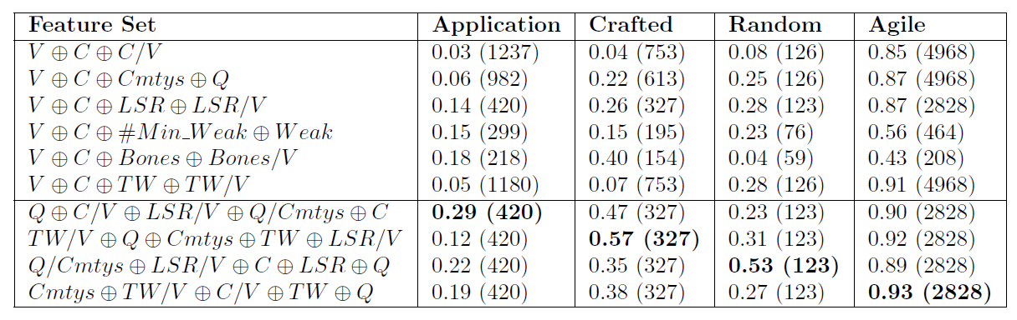
Do parameters correlate with solving time?
%
%
Values are R² from linear regression. Parenthesized values are the number of considered instances.
Bottom half of table considers all instances where we have Cmty, TW, and LSR data.

Slide 11
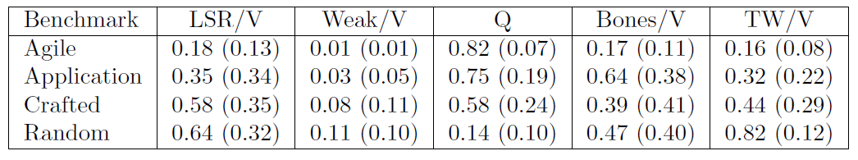
Are parameter values more favorable for real-world instances?

Slide 12
Comparing Solving Heuristics through the Lens of Parameters
How do the notions of community structure, backdoors, and backbones relate to solving performance and heuristics?
  Do better branching heuristics…
    produce proofs defined over fewer variables?
    stay more local w.r.t. the community structure?
    focus more on highly constrained variables (such as backbones)?
Considered 9 Solving Heuristics
  Branching: LRB, VSIDS, Random (with phase saving)
  Restarts: Luby, always restart after conflicts (AR), never restart (NR)
Hypothesis: Good heuristics will exhibit better “locality” (for various definitions of locality), than worse heuristics.

Slide 13
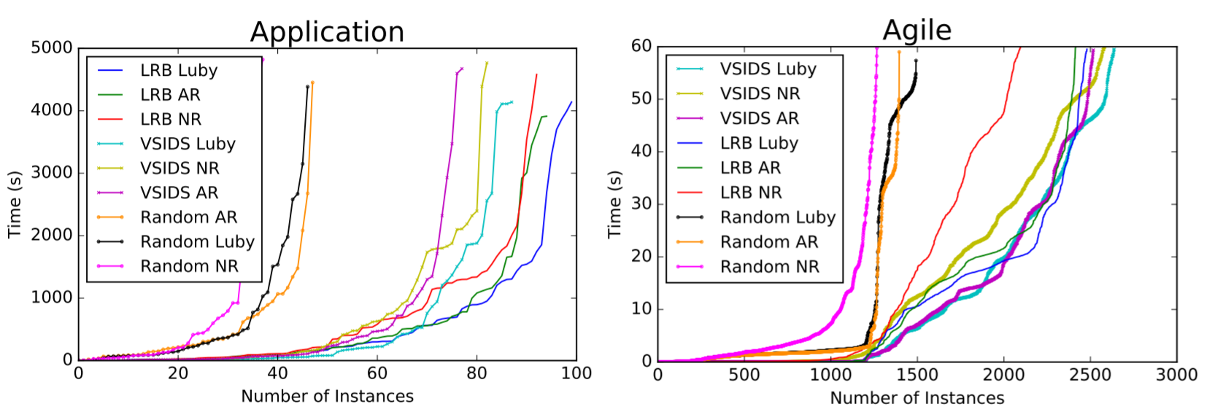
The Case Studies
Notes:
Experiments should “favor” LRB/VSIDS, and the Luby policy.

Slide 14
Do good branching heuristics produce proofs that involve fewer variables?
Effectively measure the number of unique variables in the proof found by the solver
The always restart policy consistently produces more “local proofs”
VSIDS and LRB are comparable
  20% fewer variables than Random on application instances
  50-70% fewer than Random on agile
Notes:
Approximately 30-50% fewer variables than the other restart policies

Slide 15
Are good branching heuristics local to small regions of the community structure?
VSIDS and LRB are comparable, but significantly more local than Random
Restart policies seem to have little effect

Slide 16
If the solver had a priori knowledge of the backbone, how much work could be saved?
Some heuristics for problems harder than SAT pre-compute backbones (QBF)
Results were similar for all branching heuristics and restart policies
For the application instances considered…
  On average 63% of variables are in the backbone
  68% of learned clauses are subsumed by the backbone
For the agile instances considered…
  On average 17% of variables are in the backbone
  3-5% of learned clauses are subsumed by the backbone
More data on backbone polarity flips and subsumed clauses in the paper

Slide 17
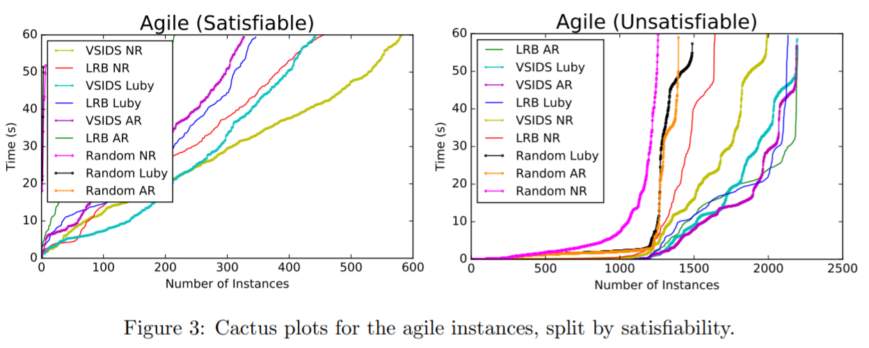
Future Work
Utilizing parameters values to alter solving heuristics online
Scaling instances

Slide 18
Related Work
[RW03] Ryan Williams et al., “Backdoors To Typical Case Complexity”
[MJ15] Mikoláš Janota et al., “Algorithms for computing backbones of propositional formulae”
[CA12] Carlos Ansotegui et al., “The Community Structure of SAT Formulas”
[CA16] Carlos Ansotegui et al., “Structure features for SAT instances classification”
[RP13] Richard Pohl et al., “Measuring the Structural Complexity of Feature Models”
[PK05] Philip Kilby et al., “Backbones and Backdoors in Satisfiability”
[YR04] Yongshao Ruan et al., “The Backdoor Key: A Path to Understanding Problem Hardness”
[ZN14] Zack Newsham et al., “Impact of Community Structure on SAT Solver Performance”
[ZL11] Zijie Li et al., “Finding Small Backdoors in SAT Instances”
[BD09] Bistra Dilkina et al., “Backdoors in the Context of Learning”
[MS08] Marko Samer et al., “Backdoor Trees”

Slide 19
Conclusions
Combinations of structural metrics can yield better predictors of SAT solver performance.
Application and agile instances have much “better” structural parameter values than crafted or random instances.
Good branching heuristics exhibit various forms of locality w.r.t. these metrics.
Structural measures can be used as a “lens” to better understand this locality and solver performance.

