Slide 1
Tie break
University of Tokyo
Seongsoo Moon
Notes:
Hi. My name is seong soo Moon from Univ of Tokyo.
I will introduce our solvers briefly.

Slide 2
Lists of solvers
Sequential solvers
  CHBR_GLUCOSE
  CHBR_GLUCOSE_TUNED
  TB_GLUCOSE
  TC_GLUCOSE (bug exist?)
Parallel solver
  ParaGlueminisat
}
Glucose + CHB [Liang+, 16]
Glucose + TBVSIDS
Glucose + CHB + TBVSIDS
Session 4A (12:00 – 12:30)
Notes:
Here are lists of solvers we`ve submitted.
All sequential solvers are based on glucose.
Our main idea was refinement of branching heuristic behalf of VSIDS.
We implemented CHB and TBVSIDS.
We also submitted parallel solver, the main idea of this one will be discussed on Session 4A.
Please attend this session and give me an advise.

Slide 3
CHB [Liang+, AAAI 16]
Conflict history-based branching heuristic
Introduced in AAAI 2016
  Title: Exponential Recency Weighted Average Branching
  Heuristic for SAT Solvers
  Solve significantly more instances than VSIDS
Notes:
We implemented CHB braching heuristic based on pseudo code introduced in AAAI 2016.
They addressed CHB solved significantly more instances than VSIDS.
So we implemented this for the competition.

Slide 4
TBVSIDS [MOON+, CP-DP 2016]
Tie break of VSIDS
  Tie occurs frequently and broken randomly in VSIDS
    “Ties are broken randomly by default, although this is configurable” [Moskewicz+, 2001]
    VSIDS in many SAT solvers uses heap array for VSIDS
  Proposal of meaningful selection from ties
Notes:
Next we implemented TBVSIDS to break ties in VSIDS. This one will be presented at doctral program in CP 2016.
Tie occurs frequently and broken randomly in VSIDS.
In original paper introducing VSIDS, they say ties are broken randomly by default, although this is configurable.
However, ties are broken randomly in many SAT solvers, because they use heap array for VSIDS and doesn`t care whether ties occur or not.
Our goal is to propose meaningful selection better than random selection done by heap structure.

Slide 5
VSIDS
Notes:
Here`s an example of VSIDS.
Each variable has activity and a variable having highest activity is chosen among variables in branch heuristic.
We pick a variable root and reconstruct heap tree.

Slide 6
VSIDS
Is this reasonable?
Notes:
Which variable we have to pick when the root is in ties?
In VSIDS, v2 is selected because it is root.
We want to differentiate these.

Slide 7
TBVSIDS [MOON+, CP-DP 2016]
×
VSIDS
TBVSIDS
Compare first by activity
If activitys are equal,
compare activityQ
Notes:
So we prepare another activity for each variable.
Variables are compared first by activity, and if activitys are equal, compare activityQ.

Slide 8
TBVSIDS [MOON+, CP-DP 2016]
×
VSIDS
TBVSIDS
Priority
In VSIDS,
In TBVSIDS,
Notes:
So if we compare variables priorities in VSIDS, only activity exists, their priorities are the same.
But in TBVSIDS, they can be ordered like this by activityQ.
So both tree can be formed under these conditions in VSIDS, but in TBVSIDS this can not be formed because v2 is lower than v6.

Slide 9
TBVSIDS [MOON+, CP-DP 2016]
×
VSIDS
TBVSIDS
Priority
In VSIDS,
In TBVSIDS,
Notes:
So in TBVSIDS, occurrence of ties would be decreased because ties occur when both activity and activityQ are equal.

Slide 10
TBVSIDS [MOON+, CP-DP 2016]
Conflict
Clause learning
Notes:
When a conflict occur, then we learn a new clause by resolution. Activities of variables relevant to resolution are updated equally.
However, we acutally learn this clause, so we want to give extra scores for these variables.
And we also give more scores when learned clause is short because they have high probability of unit propagation.

Slide 11
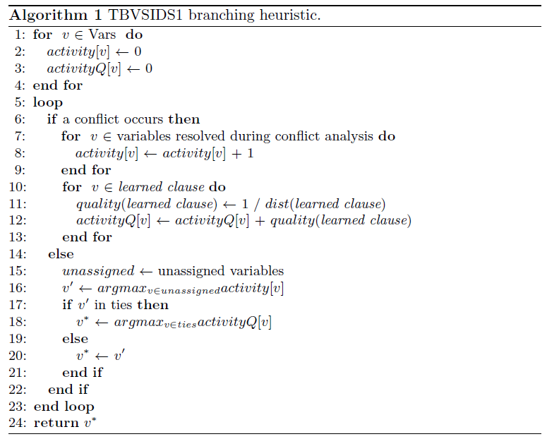
TBVSIDS1 [MOON+, CP-DP 2016]
Notes:
Here is the pseudo code of TBVSIDS1. This code performs exactly what we explained.
activityQ is updated by quality of learned clause calculated by inverse number of clause size or LBD.
We use additional array for activityQ, however we reconstruct heap here, so overhead for tie break is relatively small.

Slide 12
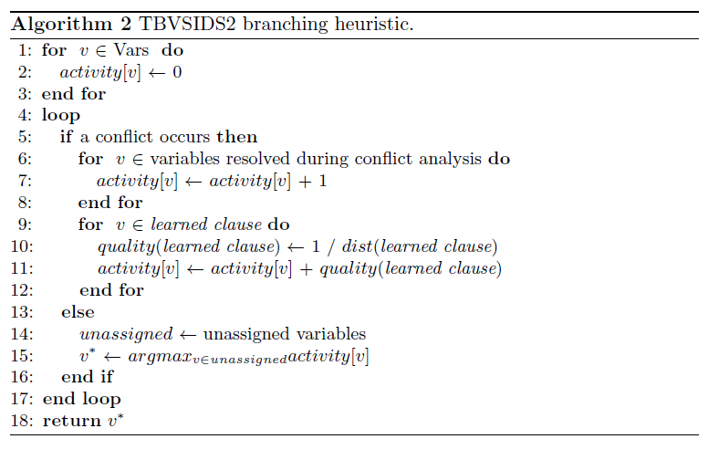
TBVSIDS2 [MOON+, CP-DP 2016]
Notes:
We also proposed TBVSIDS2. In this code, we integrated activity and activityQ into just one activity.
This hueristic do not perform tie break directly, but by adding activityQ to activity, we are expecting reduced ties occurrences, so we are still using the name of TBVSIDS.

Slide 13
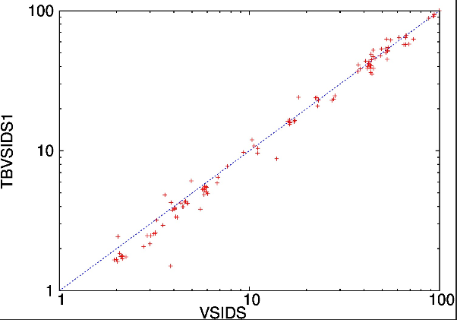
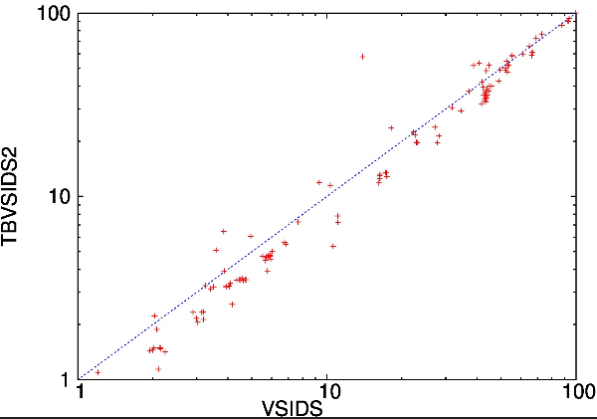
Tie occurences
Benchmarks: 300 instances from SAT Competition 2014 application track
Timeout: 1,000 s
96 / 145 (66.2 %) reduced
110 / 151 (72.8 %) reduced
Notes:
We comared actual tie occrences between VSIDS and TBVSIDS.
300 application problems from SAT competition 2014 was chosen as benchmarks, and measured occurences during 1000 seconds.
Problems solved within 1000 seconds are excluded in graph.
In both TBVISDS1 and 2, tie occurences reduced.
서로 반대 아닌지 체크해보자!!!

Slide 14
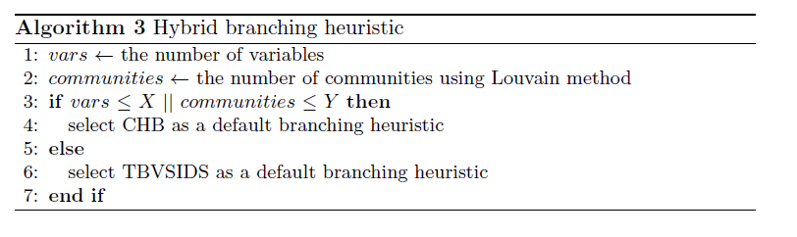
Hybrid CHB + TBVSIDS
Notes:
Next, we created hybrid branching heuristic using CHB and TBVSIDS.
Branching heuristic is selected in a preprocessing by considering the number of variables and initial number of communities extracted by Louvain method.
Numbers X and Y are determined experimetally.

Slide 15
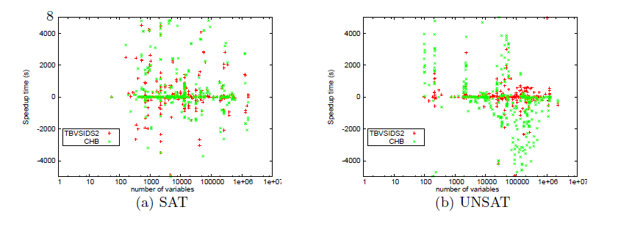
Why Hybrid?
Benchmarks: 300 instances from SAT Competition 2014 application track
Timeout: 3,600 s
Notes:
Why we created hybrid branching heuristic? That’s because we found CHB works effectively for small problems.
This graph shows speedup time of CHB against TBVSIDS2.
CHB showed speedup when problems are small and the answer is UNSATISFIABLE.
So we can improve braching hueristc simply switching CHB and TBVSIDS based on their number of variables.

Slide 16
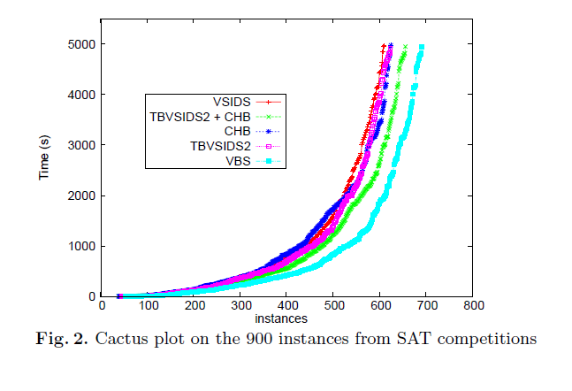
Results
Benchmarks: 900 instances from 2014Crafted, 2014App and 2015App
Notes:
Here are cuctus plot of summary.
TBVISDS and CHB solved more instances than VSIDS, but results are not that significant.
We created hybrid branching heuristic using CHB and TBVSIDS, and we succeeded to solve more instances.
There still remains a gap between VBS and hybrid one. We will try to reduce this gap in the future.

