Slide 1
Approximate History Map for Massively
Parallel Environments
University of Tokyo
Seongsoo Moon
Notes:
Hi. My name is seong soo Moon from Univ of Tokyo.
Today I’m gonna talk about approximate history map, this concept would benefit in massively parallel environments.

Slide 2
Background & Motivation
Notes:
Let`s start with background and motivation.

Slide 3
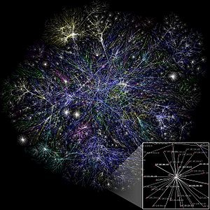
Combinatorial search
Challenging huge search space
  Learning during search
  Applied to techniques such as
Restart
Branching heuristic
  ···
Notes:
In combinatorial search, we are challenging a lot of NP complete problems and they have huge search space sometimes even infinite.
Here the search space is a graph that contains all of the possible states of the problem.
We don’t know where the answer or the optimal solution is located and the search space wetry to solve is so huge,
so we learn information during the search and these lessons are applied to techniques for efficient search
such as ; restart, branching heuristic and so on

Slide 4
Combinatorial search
Solving with several workers
  Learning and information sharing
Information classification
Class 1: Share to other workers,
maintained throughout search
Class 2: Share to other workers,
erased periodically
Class 3: Not shared, most of them are erased periodically
Notes:
And when we solve a problem with several workers in parallel, each worker learns and information is shared among workers.
We classified information into 3 categories.
Class 1, shared to other workers and maintained throughout search because it seems to be important.
Class 2, shared to others but erased periodically. It would be helpful for intensive search.
Class 3, not shared, and erased periodically. Because it seems to cost too much to share this when we consider the time and space complexity
Not because they are not useless.

Slide 5
Combinatorial search
Limitation 1
Information classification
Class 1: Share to other workers,
maintained throughout search
Erased!!
Class 2: Share to other workers,
erased periodically
Redundant
search
Class 3: Not shared, most of them are erased periodically
Notes:
After categorizing, we address current limitations.
First, class 2 and 3. These are erased periodically. And if the information is used for pruning the search space,
Then redundant search will occur after it is erased.

Slide 6
Combinatorial search
Limitation 2
Information classification
In massively
parallel environment
Class 1: Share to other workers,
maintained throughout search
Amount of
Information increases
Class 2: Share to other workers,
erased periodically
Class 3: Not shared, most of them are erased periodically
Notes:
Here we address another limitation for class 1.
Some amount of information is maintained throughout the search, but the amount of information in class 1 could be increased persistently
And this will decrease search efficiency and sometimes reach to memory-limit-exceeded.

Slide 7
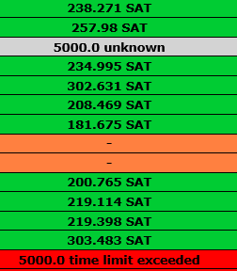
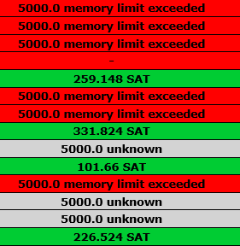
Memory limit exceeded
esawn_uw3.debugged.cnf (From SAT Competition 2014)
  Over 10,000,000 variables, 50,000,000 clauses
Sequential
Parallel
Solved: 23 / 35
Solved: 4 / 14
Notes:
This is an example from SAT Competition 2014.
This problem has a lot of variables and clauses in original CNF problem.
23 of 35 sequential solvers succeeded to solve this problem within a relatively short time.
However, only 4 of 14 parallel solvers succeeded to solve the same problem and most of them have been reached to memory limit exceeeded.
Only 12 workers are used for this problem, but memory limit exceeded.
If we try to solve bigger problems with more workers in massively parallel environments, we have to be careful of sharing information.

Slide 8
Our goal
Share information for large problems in massively parallel environments
Do not erase, maintain shared information
Reduce amount of infomation
Scalability
Approximation
History map
Worker 0
Worker n-1
Worker 1
Worker n
Notes:
Based on these backgrounds, we`ve set our goal.
To share information for large problems even in massively parallel environments, we have to reduce the amount of information.
To reduce, we use approximation.
And we maintain this information by accumulating information into a history map.
8

Slide 9
Proposals
Notes:
Now we move on to our proposals and address details.

Slide 10
Outline of Proposals
Approximate History Map (AHM)
Apply to SAT solver
  Polarity status to Search Space Index (PSSI)
  Sparsely visited area walking on Search Space (SaSS)
  extended SaSS (eSaSS)
Notes:
This is outline of proposals.
First we propose Approximate History Map. This is the general concept for sharing information in combinatorial search.
Next, we applied our AHM to SAT solver.
We propose PSSI index for AHM.
And we propose SaSS heuristic by using AHM.
Finally we propose extended SaSS heuristic.

Slide 11
Approximate History Map (AHM)
…
Divide into cells
…
Search space
…
…
…
…
…
…
…
Correspond to several areas
Density approximation
Accessible to surrounding cells fast
Each cell
Notes:
First we propose Approximate History Map.
The concept is extremely simple.
We divide search space into cells.
Each cell corresponds to several areas.
We approximate each cell`s density by counting visits.
Fast accessiblity to surrounding cells would be preferred for dynamic strategy.

Slide 12
Approximate History Map (AHM)
visit
C1
…
Applicable scenarios
Compare cells among workers
  Share information among near ones
Move to sparsely visited cell
  Diversification
Move to frequently visited cell
  Intensification
C2
…
…
…
×
…
…
…
…
…
C3
Notes:
Now we accumulate visits for each cell throughout the search.
We can apply this map to several scenarios, here are some examples.
I will give you an example.
Let`s consider a worker`s current area is located in this cell.
This cell has already visited a lot and now we want to move to sparsely visited cell.
If we consider C1, C2 and C3 as candidates, C1 and C2 are close to current cell and C3 is distant from current cell.
If we want to move to sparsely visited cell while maintaining intensive search, moving to C1 or C2 would be better choice than chosing C3.

Slide 13
Apply AHM to SAT solver
Share phases in Progress saving [Pipatsrisawat+07]
  Last assignments for each variable are saved in each phase
…
Progress saving map
v₁ v₂ v₃ v₄ v_{n-2} v_{n–1} v_{n}
time
…
T T F F F T T
No conflict
…
T F T F F T F
No conflict
…
F F T T T T F
Conflict!
…
…
F T F T F T T
Conflict!
Share to other workers
Notes:
We applied AHM to parallel SAT solver. Many solvers are using progress saving technique for intensive search.
There exists progress saving map and this map save last assignments for each variable.
So the content in progress saving map changes through the time, and after conflicts these assignments has no solutions,
We want to share these phases to avoid same situation.
However we can not share these directly because search space is too huge, we have to reduce information.

Slide 14
Proposal: Polarity status to Search Space Index (PSSI) [LION 10, MOON+]
To find pairs with high similarity of polarity status
* Comparing every polarities among all pairs is to heavy
* Dimension reduction for fast and rough comparison among workers
For m workers (w₁, w₂ … , w_{n})
compare(w_{i}, w_{j})
compare(x, y)
compare each variables
Complexity: O(m² * n)
1) Divide variables to blocks
Variable set
B₁
B₂
…
B_{k}
2) Convert each block’s status b_{i} (I = 0, 1, …, n) to 0 ~ m - 1 based on TRUE ratio in block
B₁
= 2
B₂
= 3
…
B_{k}
= 1
3) Calculate search space index
Complexity: O(m² + m * n)
PSSI = ∑ (b_{i} * m^{i})
Notes:
So we proposed PSSI, we’ve already presented this concept in LION 10, was held last moth in Italia.
What we are doing is to convert each phase into an integer.
Here the polarity status indicates each phase in progress saving map.
How to covert?
First, we divide variables into blocks, and count TRUE ratio in each block and convert to an integer.
After that, we integrate integers from all blocks and convert into an integer.
This is very simple, and now we can convert each phase into an integer.

Slide 15
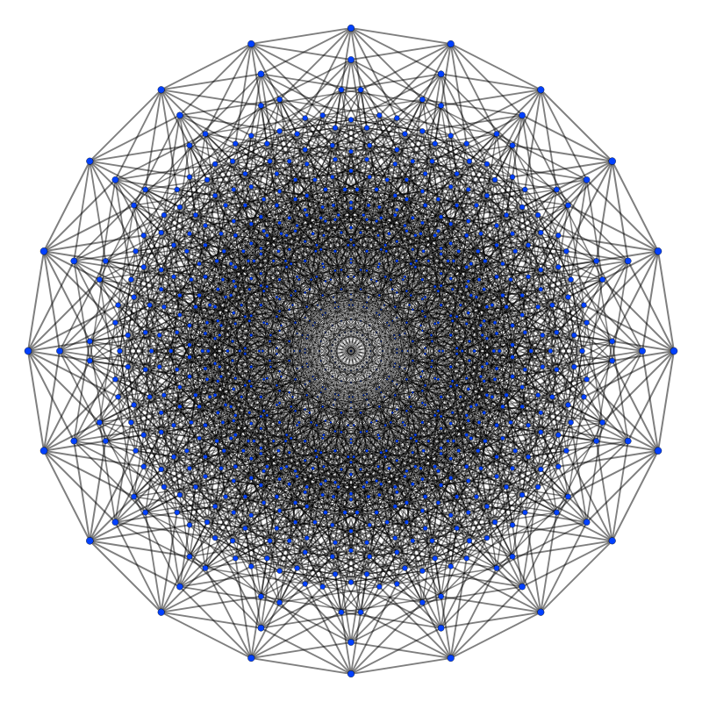
Proposal: Polarity status to Search Space Index (PSSI) [LION 10, MOON+]
Consider PSSI on orthographic projection
of 10-dimensional hypercube
Assumption
Solutions might be found in
many different areas in search space
B_{i}
∈ {0, 1, …, m - 1}
X_{i}
∈ {-1, 1}
: PSSI
: Solutions
Notes:
Why we use PSSI for history map?
Because our intuition was that solutions might be found in many different areas in search space.
We’ve already reduced dimension using PSSI, now let’s reduce dimension one more time for explanation.
Let’s project PSSI space onto 10-dimensional hypercube.
Now this hypercube represents search space for a problem. Our assumption is, there exists a lot of solutions like this.
If we solve this problem using an parallel solver with 4 workers, and their current PSSIs are located liked this.
In this situation, if each worker search only the surrounding areas from current area, a solution can not be found.
It would be better to change the current area more robustly to find a solution.

Slide 16
Proposal: Polarity status to Search Space Index (PSSI) [LION 10, MOON+]
Is PSSI appropriate index to represent search space?
Obtained 70 solutions from 4 benchmarks
70 solutions correspond to 67 different PSSI
Solution 1
PSSI 1
Solution 2
PSSI 2
Solution 3
PSSI 3
Solution 4
PSSI 4
Solution 67
PSSI 67
Solution 68
Solution 69
: PSSI
Solution 70
: Solutions
Notes:
Here remains a question when there are a lot of solutions in a search space, they actually have different PSSIs?
We performed preliminary tests using 4 benchmarks from SAT competition 2014.
We performed 20 tests per benchmarks total of 80 tests.
We obtained 70 solutions and calculated their PSSIs.
67 different PSSIs were found in 70 models, this indicates that for some problems there exist a lot of solutions
and they are located in many different areas in the search space,
and these areas might be differentiated through the PSSI.

Slide 17
Proposal: Sparsely visited area walking on Search Space(SaSS)
[LION 10, MOON+]
History map
k^{m} cells
k: Block count
Block status ∊ {0, 1, …, m - 1}
W0
W1
・・・
W2
Update history map from each worker respectively
If update count exceeds cthreshold, it is allowed to move to target cell
{r”₁, r₂, …, r_{k}}
{r₁, r”₂, …, r_{k}}
・・・
{r₁, r₂, …, r”_{k}}
Current cell = {r₁, r₂, …, r₁₀}
・・・
{r₁, r₂, …, r_{k}}
Move to an cell
Having minimum density
from cells under D_{h} ≤ 1
・・・
{r’₁, r₂, …, r_{k}}
{r₁, r’₂, …, r_{k}}
・・・
{r₁, r₂, …, r’_{k}}
|r₁ – r’₁| ≤ 1, |r₁ – r”₁| ≤ 1
Notes:
Next we introduce our SaSS heuristic based on history map. This was also introduced in LION 10 last month.
All workers share history map, and each worker updates history map every n conflicts.
When cumulated PSSIs exceed a threshold, SaSS heuristic starts.
Surrounding cells are calculated by bitwise operation.
We choose a cell with lowest frequency among surrounding cells as a target cell and change the preferred polarity
And we can dynamically move onto sparsely visited area using this heuristic.

Slide 18
Proposal: Extended Sparsely visited
area walking on Search Space(eSaSS)
Biased random walk
Density evaluation
Notes:
To improve SaSS, we propose extended SaSS.
No that experiments on eSaSS have not yet been performed.
We are on preliminary stage. We are considering 2 methods.
18

Slide 19
Proposal: Extended Sparsely visited
area walking on Search Space(eSaSS)
: current cell
Biased random walk
: surrounding
SaSS
eSaSS
: density of
Notes:
Firstly, we propose biased random walk.
In SaSS, we choose the cell having the lowest density deterministically.
For example, here are current cell and surrounding cells and we have their densities.
Then cell c3 will be chosen deterministically because its density is zero.
In eSaSS, we propose to choose cell more dynamically with probability.
19

Slide 20
Proposal: Extended Sparsely visited
area walking on Search Space(eSaSS)
Biased random walk
Notes:
I will explain how to calculate each cell`s probability.
Consider S is a set of current cell and its surrounding cells.
We calculate each cell`s weight by the inverse number of its density.
When density equals zero, constant T is allocated and this is bigger than 1.
Now we allocate each probability based on their weights.
So, in this example sum of these probability is exactly one.
20

Slide 21
Proposal: Extended Sparsely visited
area walking on Search Space(eSaSS)
: current cell
Density evaluation
: surrounding
SaSS
eSaSS
1 / 10
1 / 10
10 / 10
10 / 10
5 / 10
0 / 10
5 / 10
0 / 10
density
cell size
Notes:
Secondly, we propose density evaluation.
Now each cell has density and cell size.
If we apply biased random walk, then each cell will have probability to be chosen.
21

Slide 22
Proposal: Extended Sparsely visited
area walking on Search Space(eSaSS)
: current cell
Density evaluation
: surrounding
SaSS
eSaSS
1 / 100
1 / 100
×
10 / 100
10 / 100
×
×
5 / 100
0 / 100
5 / 100
0 / 100
density
cell size
Notes:
However, if cell size is big enough compared with its density, we want to refrain from changing current cell.
Because this cell is still not investigated enough, and frequent changes of search space will make intensive search worse.
So we prevent to move to other cells.
22

Slide 23
Proposal: Extended Sparsely visited
area walking on Search Space(eSaSS)
: current cell
Density evaluation
: surrounding
SaSS
eSaSS
1 / 100
1 / 50
10 / 100
10 / 70
5 / 100
0 / 100
5 / 20
0 / 30
density
cell size
Notes:
We are also considering dynamic changes of cell size.
We split search space into cells and their initial size is the same.
However their sizes will be changed during the search, we will take account of these changes.
23

Slide 24
Proposal: Extended Sparsely visited
area walking on Search Space(eSaSS)
Density evaluation
  Use coupon collector's problem
    how many coupons to purchase to complete a collection
: collection size cell size
Notes:
To do these things, we use coupon collector`s problem.
This is a problem of how many coupons we have to buy on average to complete a collection.
It takes T times on average to complete a collection.
Here, m is collection size so we can apply m is cell size.
24

Slide 25
Proposal: Extended Sparsely visited
area walking on Search Space(eSaSS)
Density evaluation
  Use coupon collector's problem
    how many coupons to purchase to complete a collection
Change cell when over 80 percents of cell is visited
Notes:
For example, if we want to change cell when over 80 percents of cell is visited, then expected number changes like this.
And we change cell when the density of cell gets bigger than Threshold.
Threshold is divided by n, because we only update cells on every n conflicts.
25

Slide 26
Experiments
Notes:
Now we move on to our experiments.

Slide 27
SaSS test
Base solver: ParaGlueminisat
Thread num: 12, 64
Benchmark: 100 application probs from SAT Race 2015
TIMEOUT = 3600 seconds
 | SaSS |  | Non-SaSS
Workers | 64 | 12 | 64 | 12
Solved (Average) | 66.5 | 62.5 | 61.5 | 57.5
Average 7% speed up in running time
Notes:
We evaluated SaSS by implementing this to our base solver ParaGlueminisat. This is a parallel version of glueminisat.
100 application problems from SAT race 2015 was chosen as benchmarks.
SaSS solved 5 more problems than non-SaSS in both 12 workers and 64 workers.

Slide 28
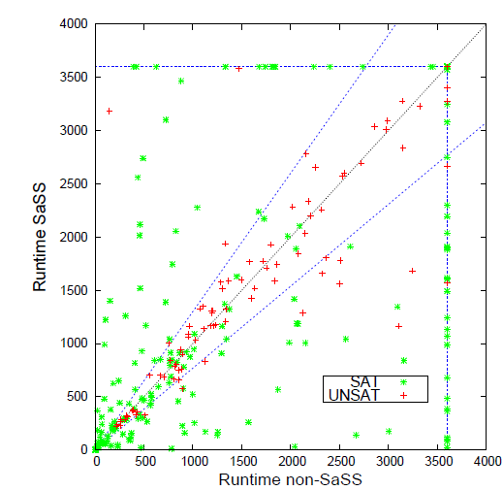
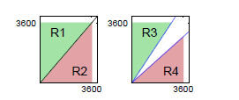
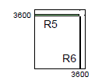
SaSS test
 | SAT | UNSAT
R1 : R2 | 82 : 99 | 40 : 46
R3 : R4 | 51 : 68 | 4 : 13
R5 : R6 | 14 : 26 | 1 : 5
Notes:
We also compared SaSS and non-SaSS with scatter plot.
Regions R1 and R2 are divided by the line of y=x and simply counts which one was faster than the other.
In regions R3 and R4, region of satisfying both these equations is excluded because their running time is not that different.
By comparing R3 and R4 we can compare speedup more strictly.
Resions R5 and R6 count instances solved by only one side.
In all cases, SaSS surpasses non-SaSS.

Slide 29
Conclusion
What we did
  Proposal of AHM to share information for massively parallel environments
  Apply AHM to parallel SAT solver
    PSSI, SaSS, eSaSS
Future work
  Evaluate eSaSS for parallel SAT solver
  Apply AHM other scenarios in SAT problems
  Extend to other CP areas
Notes:
To summarize, we proposed AHM this is a general concept for sharing information in combinatorial search.
We applied this to parallel SAT solver by reducing the amount of information using PSSI,
And proposed SaSS heuristic to change the area of search space dynamically.
We also proposed extended SaSS, we will implement and evaluate this in the future.
Our next step is to apply AHM to other scenarios in SAT problems such as how to share learned clauses among workers.
We are also considering to extend our concept to other CP areas.

Slide 30
Thank you for your patience

Slide 32
Comparison with top solvers
UNSAT | AVT | Solved
Glucose-update | 698 | 32
plingeling | 594 | 28
treegeling | 1060 | 26
ParaGlueminisat + SaSS | 896 | 31
SAT | AVT | Solved
Glucose-update | 646 | 46
plingeling | 726 | 45
treegeling | 623 | 47
ParaGlueminisat + SaSS | 574 | 48
Notes:
지울까 이거? 왜냐믄 실제 소스 코드로 돌린거 아니자나?

Slide 33
For presentation
No need to try explain everything
  Maybe difficult parts would be needed
Concentrate on some parts and explain them politely
Prepare Q/A
Explain diversity and intensity figure in p.7-8
Example of diversity and intensity
Example of progress saving
Notes:
結論です。今回、中腹探索を減らし、多様性を増やすためのmetricとしてPSSIを提案しました==➔
また、探索の高速化のために余分のクローズを追加する手法を検討しています。+
今後の予定としては、今回PSSIを用いて探索空間を切り替えることのみを行いましたが、このmetricを用いて、学習クローズをコントロールすることもできるのではないかと思っているので、適用してみるつもりです。
また、６４coreで１２coreより性能が落ちる理由をprofilingしたり、分析して改良していくつもりです。
ここまでできたら、超並列での改良もチャレンジしてみたいと思っています。

Slide 35
About SAT solver
Solve CNF-type SAT problem rapidly
If we use SAT solver…
clause
literal
literal x
  (a V b V c) Λ (a V ¬c) Λ (¬b V c)
Variable x
literal ¬x
encoding
Prob 1
CSP 1
Solver 1
modeling
encoding
Prob 2
CSP 2
Solver 2
・・・
・・・
・・・
modeling
encoding
Prob N
CSP N
Solver N
Notes:
次は、SAT solverについてです。ソルバはCNF型の問題を解きます。問題はリテラルとクローズで構成されます。
変数Xに対して、そのままのものとその否定をそれぞれ別のリテラルとして扱います。
このとき、リテラル同士はOR、クローズ同士はANDで結ばれた形がCNF型です。
SATソルバを用いる理由を大雑把に説明すると、様々な問題に対して独自のソルバを作ることは可能ですが、改良と保守など様々なコストがかかります。

Slide 36
About SAT solver
Solve CNF-type SAT problem rapidly
If we use SAT solver…
clause
literal
literal x
  (a V b V c) Λ (a V ¬c) Λ (¬b V c)
Variable x
literal ¬x
modeling
Prob 1
CSP 1
encoding
modeling
encoding
Common Solver
Prob 2
CSP 2
・・・
・・・
modeling
encoding
Prob N
CSP N
Notes:
なので、このように共通のソルバで様々な問題を解かせましょう。これでいくら問題が増えてもモデリングさえすれば解けるので、様々な分野の研究者がソルバの改良の研究をしています。

Slide 37
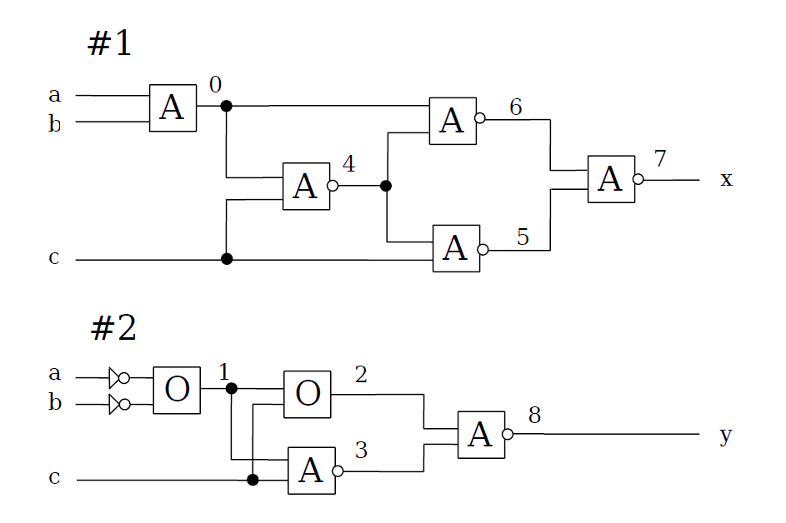
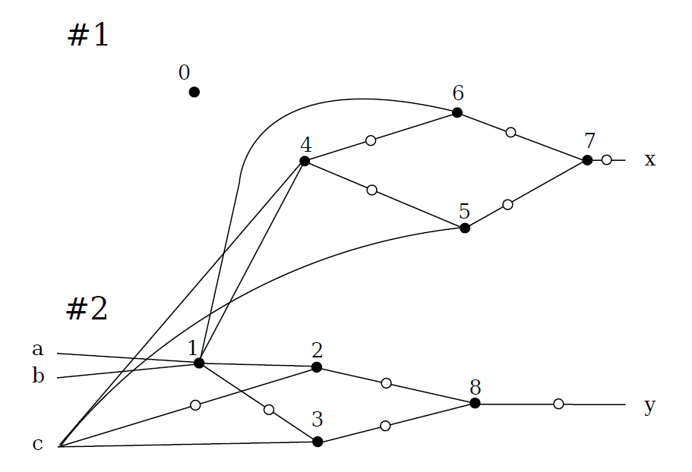
Applied areas
AI applications (planning, scheduling, puzzle …)
SW / HW verification
Equivalance checking through AIG (And/Inverter Graph)
https://www21.in.tum.de/~lammich/2015_SS_Seminar_SAT/resources/Equivalence_Checking_11_30_08.pdf
Notes:
実際Application問題の応用例ですが、スケジューリング、パズル、回路検証など様々な分野で用いられています。特に、IBMやMicrosoftでも回路検証のためにSAT solverに関する研究を行っています。

Slide 38
About parallel SAT solver
Mainly 2 approaches
Wi: worker i
  Divide-and-conquer
  Using guiding path to divide search space
  Major drawback: load balancing
  Portfolio
  No division of search space
  Each pair of workers collaborate
  through learnt clause
Original problem
W0
W3
W2
W1
W2
W0
W1
W0
W1
  Share learnt clause
Notes:
前回にまではsequentialソルバも少しやってましたが、現在はparallel solverに集中しています。
大きく2つの方式があります。まず、分割統治ですが、問題を分割するので、ワーカ間のロードバランスを保つことが難しい短所があります。
しかし、超並列のクラスター環境ではよく用いられます。
最近良く用いられている手法はportfolioです。問題の分割なしでそれぞれのワーカは競争的かつ協同的に探索をします。

Slide 39
About parallel SAT solver
Recent major approach is portfolio
  Both diversity and intensity are important
  Allocation of different search policies
    Diversity
  Sharing of learned clauses
    Diversity , intensity
  Random selection?
    Diversity && intensity
Original problem
Diversity
W0
W3
W1
W2
Intensity
Notes:
Portfolioでは一般的にdiversityとintensityのバランスが大事だといわれています。各ワーカはパラメータチューニングや違うポリシーの割り当てなどでDiversityを確保し、互いに学習クローズを共有することでIntensityを確保します。
なので、例えばそれぞれのワーカで変数をランダムで選ぶようにすると、多様性の確保はできるかもしれないが、集中的な探索はできなくなる可能性が高くなります。

Slide 40
Limitation and proposal
Allocation of different search policies
  Not suitable for massively parallel environments
  Sharing of learned clauses
  Only short clauses are shared
  Clauses are removed periodically
All workers use same search policies
To share information and maintain
1. Compress information
2. Accumulate these as history map
Notes:
Currently, portfolio based parallel solvers solve problems efficiently, however the scalability of this approach has not been studied sufficiently.
We address current limitations and propose solutions.

Slide 42
Combinatorial search
Challenging huge search space
  Techniques for efficient search
Branching heuristic
Restart
Constraint learning
  ···
Notes:
In combinatorial search, we are challenging a lot of NP complete problems and they have huge search space sometimes even infinite.
Here the search space is a graph that contains all of the possible states of the problem.
We don’t know where the answer or optimal solution is located and the search space we are challenging is so huge,
So we are handling to solve problem efficiently with several techniques; branching heuristic, branch and bound or reinforcement learning.
And we solver a problem with several workers in parallel

Slide 43
Which information
Save last assignments for each variable
Save here!
Progress saving
…
T T F F F T T
Decision
level
…
0 1 2 3 k-1 k k+1
Assignment
…
T T F F F T T
T T
Backtrack
Conflict
Erase assignments
Notes:
どの情報を共有するかですが、Progress saving という要素技術があり、これを用いることにしました。

Slide 44
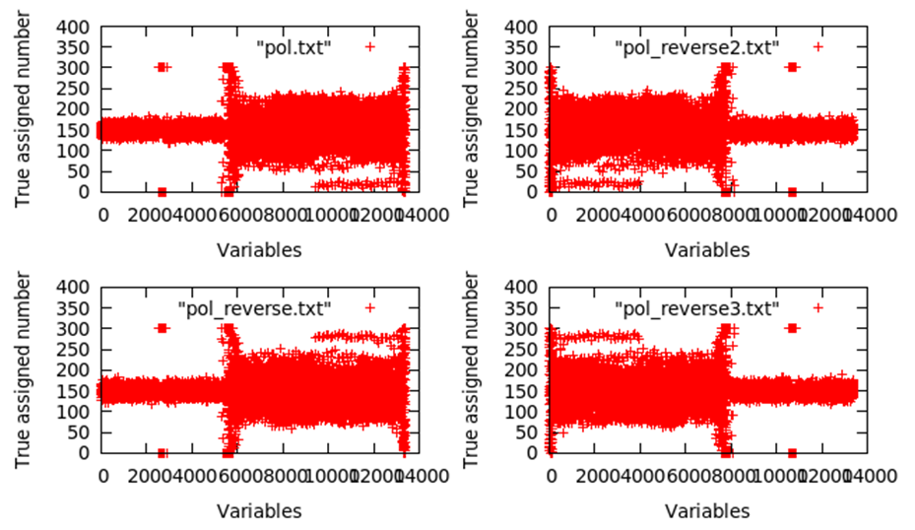
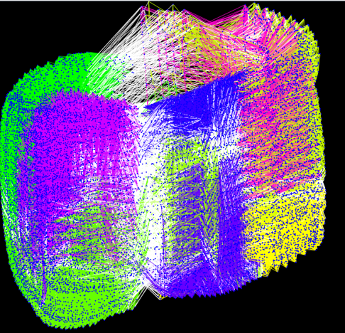
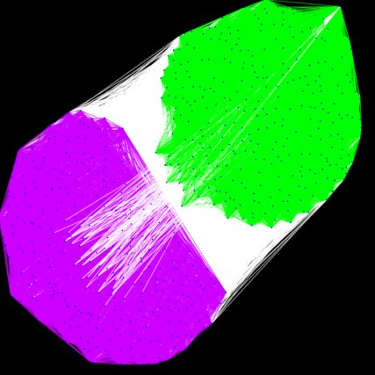
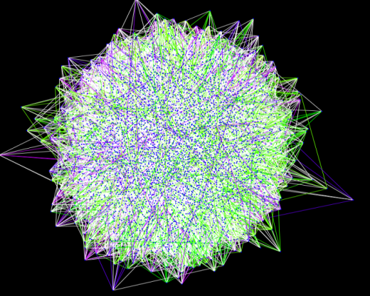
Characteristic of application problem
Community structure
True assign rate from repeat test
Application
Random
Notes:
Application問題はなぜ別の研究をして扱われるかというと、やはり問題の中に潜んでいるHidden structureがあるためです。
まず、左はそれぞれの問題のCommunity 構造を可視化した図で、同じCommunityに属していると同じ色で塗られています。Randomで生成された問題と比べて、Application問題はCommunity構造を持っていることが分かります。
右の図ですが、Application問題の中で１つの問題を選び、繰り返しテストでそれぞれの変数のTrue Assignmentの割合の平均を取ったグラフです。変数のindexを変えたり、それぞれの変数を反転した問題を作ったりして、
元問題に変形を加えても、問題の構造が見つかることを確認しました。

Slide 45
Elements to speed up SAT solver
Restart policy
  Luby restart [M. sinclair+ 93]
  Glucose restart [Audemard+ 12]
Literal decision heuristic
  VSIDS [Moskewicz+ 01]
  BerkMin [E. Goldberg+ 02]
Learnt clause sharing
  AIMD feedback [Youssef+ 11]
Notes:
それぞれの要素技術の詳細については時間の都合上、省きたいと思います。
Restart: To obtain diversification in search, Luby restart -> Glucose restart, more aggressive, dynamic method
VSIDS, etc. BerkMin, VMTF, CBH
AIMD (Additive Increase / Multiplicative Decrease)
5

Slide 46
Challengeable Categories
Generated by
Classified as
Application
(Model checking, Planning, cryptography …)
SAT
Crafted
(Hard-combinatorial)
Certified UNSAT
Random
(3-SAT, 4-SAT, …, N-SAT)
SAT + UNSAT
Notes:
じゃ、どういった研究ができるかのカテゴリーですが、まず問題の生成の観点で見ると、Application問題、難しく設計された問題、ランダムの問題に分けられます。
モデルの観点でみると、SATとなる問題に対して早くモデルを見つける研究、UNSATである問題に対して早く証明する研究、SATかUNSATかを特定せずに一般的な性能を上げる研究が考えられます。
私は、この中でApplcationでかつ、SAT、UNSAT両方に有効なソルバに関する研究をやっています。

Slide 47
About SAT solver
Solve CNF-type SAT problem rapidly
If we use SAT solver…
clause
literal
literal x
  (a V b V c) Λ (a V ¬c) Λ (¬b V c)
Variable x
literal ¬x
Original
Problem
modeling
CSP
encoding
SAT
Rapid SAT
Solver
CSP
Solution
decoding
SAT
Solution
Notes:
次は、SAT solverについてです。ソルバはCNF型の問題を解きます。問題はリテラルとクローズで構成されます。
変数Xに対して、そのままのものとその否定をそれぞれ別のリテラルとして扱います。
このとき、リテラル同士はOR、クローズ同士はANDで結ばれた形がCNF型です。
SATソルバの意義を簡単に言うと、

Slide 48
Proposal: Search space change
Original
CNF
SAT Solver
Original
CNF
Index shuffling
Re-indexed
CNF
SAT Solver
Preprocessing method before any other processes
Randomized index orders of variables may produce some diversity
Notes:
そのために私はISOVを提案します。非常にシンプルなpreprocessingです。問題をソルバに渡して探索を始める前にshuffleを行うのみです。一般的にソルバは様々なheuristic algorithmのポリシーによって探索spaceを変えながら探索し続けますので、何かを選ぶときにtieが発生したら、選ばれるものには偏りがあるかもしれません。ここで、shuffleにより少し多様性が加わるのではないかと思いました。

Slide 49
Proposal: Index Shuffling of Variables
(ISoV) for parallel SAT solvers
Re-indexing table
Origin problem
After shuffling
x₁ → x₃
x₂ → x₄
x₃ → x₂
x₄ → x₅
x₅ → x₆
x₆ → x₁
( x₁ V x₂)
( x₃ V x₄)
( x₂ V x₃ V ¬x₅)
( x₄ V x₂ V ¬x₆)
(¬x₄ V x₆)
(¬x₅ V x₁)
( x₃ V ¬x₆)
( x₂ V ¬x₁)
Notes:
やり方として単純にランダムで変数のindexをshuffleします。Re-indexing tableを用意し、それに沿って各clauseのそれぞれのindexを変更します。

Slide 50
Experimental Environment
Operating System: Ubuntu 14.04.2 LTS
Processor(s): 2 Hex-core Xeon 5680 3.33GHz
Memory: 144GB 16x9G 3 DDR3-1333MHz
Compilers: GCC 4.8.2
Notes:
次にISoVの実験結果に移ります。
実験はこうような環境で行いました。

Slide 51
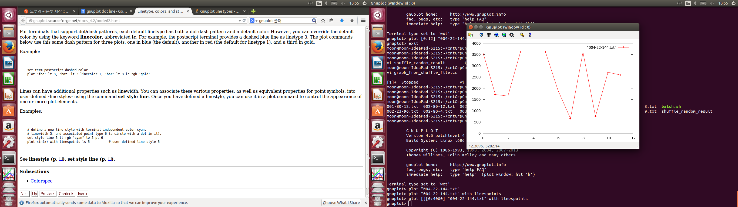
Runtime changes through ISoV
time (s)
Seed num
Notes:
51
まず、1つの問題に対してやってみた結果です。ベースソルバはminisat2.2です。
Time limitは１時間に設定していて、seed値を変えながら実行時間を測定しています。
元問題を解いたのがseedの0のところで、元問題のままだと解けなかったのが、ISoVにより、11回の中7回解けるようになりました。

Slide 52
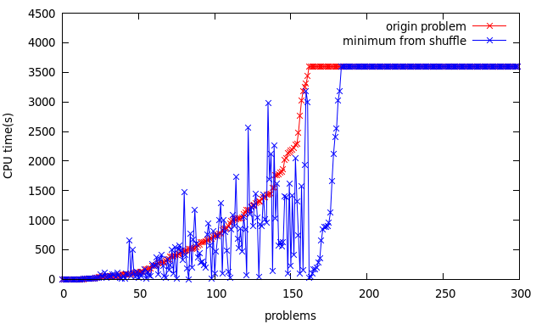
Comparison of origin problems and shuffled problems through ISoV
Benchmarks
  300 application problems from SAT Competition 2014
Notes:
次は、2014年Sat competition application 部門300問題を用いて一般的な性能を測って見ました。同じく、1時間をTIMEOUTで設定して実験を行いました。X軸がそれぞれの問題を表していて、元問題の求解時間が早い順でソートしています。
赤い線は元問題を解いた結果なので、実行時間の短い順でソートされています。
青い線は、ISoVを11回seed値を変更しながら行い、その中のベスト時間をプロットしたものです。
たまに元問題のほうが実行時間が短い結果も見えますが、全体的に改良された問題が多いということがわかります。
난수 시드를 바꾸는 것만으로는 이렇게 안되는 것을 말하자
그래프 만들어 보자

Slide 53
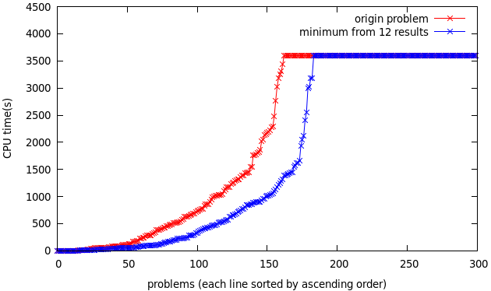
Hypothetical performance of ISoV in parallel solver
Benchmarks
  300 application problems from SAT Competition 2014
Notes:
次は、このグラブは、元問題と11回のISoVを合わせた、12回の中のベスト時間と元問題の実行時間を比較したグラフになります。
なので、並列12スレッドでこの手法を適用した場合、この間のスペースだけの時間を減らすことができると予想されます。

Slide 54
Result summary of ISoV
 | Original Problem | ISoV (11 times) | Original + ISoV
Solved count | 162 / 300 | 183 / 300 | 183 / 300
AVT (ALL) | 2051s | 1761s | 1724s
AVT (Both solved) | 732s | 523s | 454s
Notes:
表にまとめるとこのようです。
解けなかった21問題を解くことができました。
全体の平均時間を比較してみても、短くなっていて、特に両方解けた問題のみを対象にしても時間を短縮することができました。

Slide 55
Why ISoV changes execution time?
ISoV diversifies of variable decision heuristic
Most of SAT solvers use VSIDS as decision heuristic
VSIDS [Moskewicz+ 01]
  Each variable has a Activity, initialized to 0
  When a clause added, Activity associated with each literal in the clause is incremented
  Ties are broken randomly by default, although this is configurable
  Periodically, each Activity is divided by a constant
Call this Tie break
Notes:
次に、ISoVが多様性を加える理由を説明します。
これは変数のdecision heuristicとして用いられるVSIDSとの関連があります。
VSIDSで、ぞれぞれの変数はActivityを持ち、このような手順で動作します。
この手順で3番を注目するとtieをランダムにbreakすることが書いてあります。しかし、sequentialソルバではランダムに選ぶことは余計なコストがかかるだけなので、実装されていません。
これの実装を行い、Tie breakと呼ぶことにします。
ISoVで多様性が加わるのは、tie breakのようにtieのとき選ばれる変数の順序が変えるからであると考えられます。

Slide 56
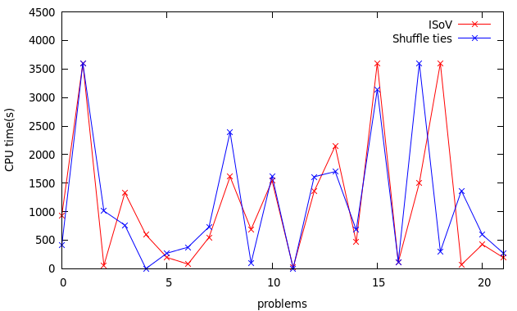
Comparison of ISoV and Tie break
Benchmarks
  21 problems of additionally solved by ISoV
Demerits
  Tie break
  Overhead to pick
  a variable from ties
  ISoV
  Cache shuffle table
  Converting required
  when sharing clauses
  in parallel solver
Notes:
なので、２つの比較実験を行いました。その結果ですが、かなり似ている結果が得られましたが、実は2つの手法には大きな違いがあります。
Tie breakは、tieが発生する度にbreakする必要があり、選ぶためのコストがかかり、特に頻繁にtieが発生し、tieになる変数の数が大きい場合はコストが高くなります。
ISoVですが、shuffleするので、idxを元に戻すためのtableが必要です。なので、parallelでこの手法を用いるとすると、
Clauseを共有するときに毎回idx変換を行うためのコストがかかります。

Slide 57
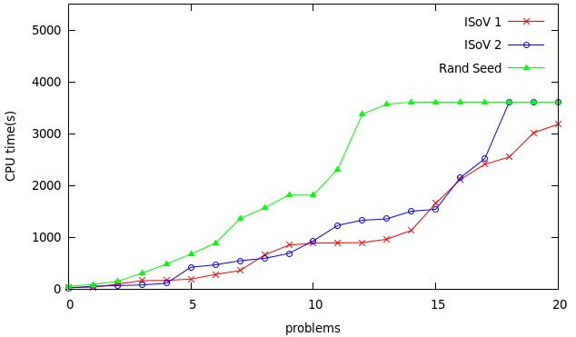
Comparison of ISoV and Random seed
Benchmarks
  21 problems of additionally solved by ISoV
Notes:
난수 시드를 바꾸는 것만으로는 이렇게 안되는 것을 말하자
그래프 만들어 보자

Slide 58
Conclusion
Proposal of ISoV
  Extremely simple preprocessing method
  Diversification verified through benchmarks
  Applicable easily on existing other solvers
Notes:
まとめです。今回多様性を加えるためのISoVという簡単なpreprocessing手法を提案しました。
いくつかのベンチマークで多様性が加わることを検証しました。
この手法は非常に単純なため、余分のコストがほぼ発生しない軽い手法でかつ、他のソルバにすぐ適用できるようなものなので、汎用的な手法として用いられるのではないかと思います。
초병렬일때 셔플이 다양성을 내기 쉽다는 것을 강조하자

Slide 60
Proposal: Polarity status to Search Space Index
Consider PSSI on orthographic projection
of 10-dimensional hypercube
Assumption
Models might be found in
many different search spaces
B_{i}
∈ {0, 1, …, m - 1}
X_{i}
∈ {-1, 1}
: PSSI
: Models
Notes:
なんでこういったIndexを定義するかの動機ですが、とりあえず、説明しやすくするために、それぞれのブロックの０からｍ－１までの数字を前の半分は-1、後ろの半分は1に変換して
十次元のhypercubeで考えましょう。
例えば、これが1つの問題に関するそれぞれの探索空間を表しているとしましょう。そして、ここで青い点が実際にこの問題のモデルが見つかる領域だと考えましょう。
ここは、自分の推定ですが、おそらく、SATとなる問題は様々な空間でモデルが見つかるだろうという仮説を立てました。

Slide 61
Difficulty of diversification
Diversity is also import in sequential solvers
VSIDS: Decision heuristic
  A variable is chosen by dynamic priority
Effort to return from futile portions of the space
  Random decision, randomize priority
    Ignore priority
    Deteriorate search status
How to diversify without destroying priority?
Notes:
並列ではワーカ間での多様性を保つことが大事ですが、sequentialソルバでも多様性は大事です。
変数のheuristicとしてよく用いられるVSIDSというものがありますが、探索状況によって動的に変数のpriorityを変更し、これによって変数を選びます。
しかし、これに沿って探索をし続けると、探索が不毛な空間に陥る可能性があるので、これを防ぐために、たまにはランダムで変数を選ぶ、priority自体を少しrandomizeするなどの手法も考慮されていますが、逆に探索を悪くする可能性が高く、最近はあまり使われていません。
なので、VSIDSのpriorityを破壊せずに多様性を加えることをすればいいのではないかと思いました。

Slide 62
Shuffle indexes of variables
Motivation
  From test of solving problem using components
Component1
TIME(Origin problem)
TIME(Component1)
(x₁ V x₂)
Origin problem
(x₂ V x₃)
(x₁ V x₃)
(x₁ V x₂)
(x₂ V x₅)
(x₁ V x₅)
(x₃ V x₄)
Component2
(x₁ V x₂)
Little bit shocked!
Notes:
それで、Minisat2.2をベースにして、いろんな予備実験をやっている内に変な結果に気づいて少しデータを取ってみました。
SAT Competition 2014年の問題を対象にして、このように、問題をcomponentに分割する実験を行い、それぞれのComponentを解いてみる実験をやっている内に、Componentが元問題より解くのに時間がかかることを発見しました。

Slide 63
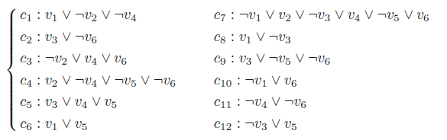
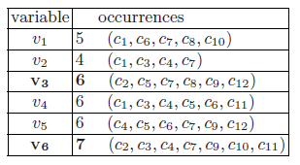



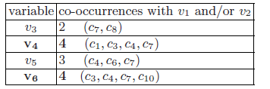
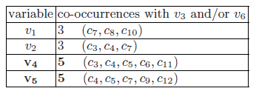


Related works - JaCk-SAT [Daniel 07]
Notes:
63
次に、問題の分割に関する既存関連研究を１つ紹介いたします。JaCkSatというものですが、Join and
checkの略字で、簡単に言うと、問題をあるポリシーに従って、半分に分割し、

Slide 64
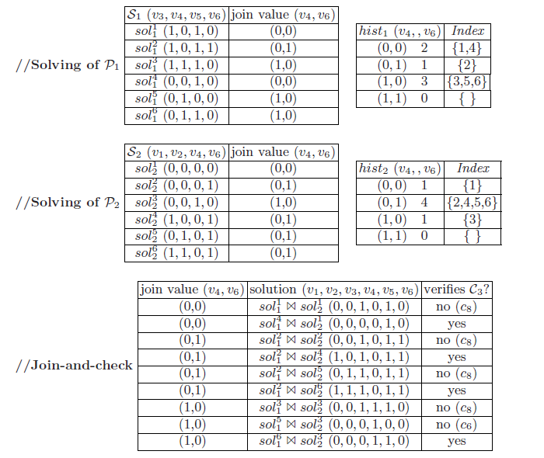
Related works - JaCk-SAT [Daniel 07]
Drawbacks
Search all solutions of
n/2 variables problems
Join-and-Check step
may be exponential
in term of n
Notes:
64
それぞれに対してすべての解を出し、求まった解をJoinさせて、残りのClauseでそれぞれを解をCheckすることをやっています。
この手法は、変数がnのとき、n/2の変数からなる問題のすべての解を出さなければならなく、その解の数によって、数が大きいとJoin-and-Checkにかかる時間も長くなる欠点があります。
変数の数が、せいぜい数百から数千ほどの小さい問題に対しては効果があるらしいです。

Slide 65
Proposal: ActivityMini for sequential SAT solvers – Improvement of tie break (1/2)
ActivityMini_V0
  Each variable has score
  Score is updated when clauses are attached / detached
  Add / subtract (1 / Length of a clause)
Current ActivityMini_V0
5
5
5
5
5
5
Attach
{x₁ V x₂)
5.5
5.5
5
5
5
5
Detach
(x₂ V x₃ V ¬x₅)
5.5
5.17
4.67
5
4.67
5
Attach
(¬x₄, x₆)
5.5
5.17
4.67
5.5
4.67
5.5
Attach
(x₃, ¬x₆)
5.5
5.17
5.17
5.5
4.67
6
Notes:
今まで述べたISoVとtie breakはparallelを想定して行った実験であり、sequentialソルバで有効な手法ではありません。
しかし、tieのときにどの変数を先に選ぶかによって結果が大きく変わるということがわかったので、tie breakで
意味のある変数を選ぶことでもっといい結果が導かれると思い、ActivityMiniというのを提案しました。
VSIDSでそれぞれの変数がActivityを持っていますが、さらにそれぞれの変数がActivityMiniを持つようにしました。
まず、ActivityMini_V0ですが、学習クローズのリストにクローズが追加、削除されるたびにそのclauseの長さ分の1を足し算、引き算してActivityMiniを更新します。
長さ分の１にした理由は、短いclauseのほうが伝播しやすいので、優先度を上げるためです。

Slide 66
Proposal: ActivityMini for sequential SAT solvers – Improvement of tie break (2/2)
2-literal watching [Moskewicz+ 01]
  To speed up propagation, watch only 2 literals in each clause
ActivityMini_V1
  Consider the size of 2-literal watching lookup table
ActivityMini_V2
  Only consider the size of 2-literal watching lookup table
In decision heuristic
  Activity is mostly preferred
  If ties exist, compare ActivityMini
Notes:
ActivityMiniで考慮しているheuristicの要素はもう1つあります。監視リテラルというものですが、
この構造に着目し、監視リテラルでのそれぞれの変数のlookup tableの長さも考慮したものがActivityMini_V1であり、この長さのみを考慮したものをActivityMini_V2としました。
正確ではないけど、ある程度、どれだけこの変数が多くの未充足のクローズに入っているかという指標として考えることができるのでこの指標も考慮したものをActivityMini_V1とし、比較として、lookup tableの長さだけを考慮したものをActivityMini_V2としました。
2 literal ->監視リテラルと説明する

Slide 67
2-literal watching [Moskewicz+ 01]
To speed up unit propagation
unassigned
unsatisfied
satisfied
w₁
w₂
w₁
w₂
¬x₁
¬x₂
¬x₃
¬x₄
¬x₅
¬x₁
¬x₂
¬x₃
¬x₄
¬x₅
w₁
w₂
Removal
¬x₁
¬x₂
¬x₃
¬x₄
¬x₅
w₁
w₂
¬x₁
¬x₂
¬x₃
¬x₄
¬x₅
¬x₂
×
w₂
w₁
×
¬x₁
¬x₂
¬x₃
¬x₄
¬x₅
Unit propagation
w₁
w₂
w₁
w₂
¬x₁
¬x₂
¬x₃
¬x₄
¬x₅
¬x₁
¬x₂
¬x₃
¬x₄
¬x₅
Notes:
こういうものです。
簡単に説明すると、それぞれのclauseに２つのポインタを置いて、そのポインタのみ監視します。それぞれのリテラルはclauseのlookup tableを持ちます。この構造により、単位伝播が高速化されました。
2-literal watchingは単位伝播の高速化をするために提案された手法です。このようにまだ未充足のクローズそれぞれに対して２つのポインタをおいて、そのポインタだけを注目します。
それぞれのリテラルは自分がポインタとして選ばれた場合のみのclauseのlookup tableを持ちます。
例えば、not x2を見ますと、上の２つのクローズはnot x2にポインタを指しているのでnot x2のlookup tableに入ります。
しかし、3番目のものはにnot x2がfalseになったので含まれません。4番目の例は、not x2はまだ値が決まっていないのにnot x2のlookup tableには入りません。説明は省きますが、これがpropagationが高速化される1つの理由です。

Slide 68
Experimental results
ActivityMini is implemented based on MiniSat 2.2
Benchmarks
  Set of 2 more fails by 12 ISoV test from SAT 2014 application 300 problems
  Time limit: 5000 sec
Solver Type | Solved / Problems
MiniSat 2.2 | 28 / 49
MiniSat2.2 + ActivityMini_V0 | 33 / 49
MiniSat2.2 + ActivityMini_V1 | 35 / 49
MiniSat2.2 + ActivityMini_V2 | 28 / 49
Notes:
実験の結果ですが、MiniSat 2.2をベースにしてやりました。
結果、lookup tableの情報だけでは結果はよくならなかったですが、2つの指標を組み合わせたV１でもっとも良い結果を出すことができ、Sequentialソルバを改良することができました。

Slide 69
Applying to other solvers
Previous experiments base solver: MiniSat
Apply ISoV to SOTA sequential solvers
  Lingeling [Biere 11]
  Glueminisat [Nabeshima 12]
  ParaCIRMiniSAT [Sonobe+ 11]
Glueminisat
  2011 SAT competition application SAT + UNSAT Silver medal
  Based on MiniSat
  LBD [Audemard 09]
  ActivityMini tested
Notes:
ここまでの実験はすべてMiniSatをベースにして行っています。MiniSatはとても汎用的なソルバで、おおくのソルバのベースとなっていますが、最近のソルバに比べるとかなり性能が落ちるので、ここまで述べた手法が最新のソルバにも効果があるかを試すためにいくかのソルバに適用してみました。
まず、いくつかのソルバにISoVを適用してみました。結果、shuffleにより大きく求解の時間が変わり、多様性を加えることを確認しました。
その中でGlueminisatの結果を見せます。このソルバは2011年、2012年にコンペで銀メダル取った優れたソルバです。
クローズの長さを評価する方法をとして、LBDという概念を使っています。このソルバに ActivityMiniを適用してみました。

Slide 70
LBD (Literal Blocks Distance)
Learned clause
{¬x₁, x₂, ¬x₃, x₄, x₅, ¬x₆}
{¬x₁, x₂, ¬x₃, x₄, x₅, ¬x₆}
Decision level
7 5 5 2 2 2
7 5 5 2 2 2
Decision Stack
Blocks
LV 0
LV 1
LV 2
x₄
¬x₆
x₅
LBD = 3
LV 3
LV 4
LV 5
x₂
¬x₃
LV 6
LV 7
¬x₁
Notes:
LBDは、詳しい説明は省きますが、このように変数をある手法でブロック化し、そのブロックの数でclauseの長さを評価する手法です。
LBDを簡単に紹介します。LBDは学習クローズをDecision levelで見た場合にいくつのブロックに分けられるかを表す指標です。
SAT solverの探索にはDecision stackがあって、それぞれのDecision levelである変数にtrueがfalseを与え、propagationします。
この例では、Level2でx4にtrueを与えることで、x6はfalse,x5はtrueになるようにpropagationが起きたとしましょう。
LV７まで進み、conflictが起き、このようなclauseが学習されたとします。それぞれの変数をDecision levelはこのようになり、
同じlevelのものを1つのblockにまとめると、このように3つのブロックができ、LBDは3と評価されます。

Slide 71
Experimental result
Benchmarks
  SAT 2014 application 300 problems
  Time limit: 5000 sec
Solver Type | Solved / Problems | Average cost (s)
Glueminisat | 229 / 300 | 1780
Glueminisat + ActivityMini_V1 | 232 / 300 | 1800
Lingeling (2014 SAT competition top solver) | 231 / 300 | 1989
Notes:
GlueminisatにActivityMiniを適用した結果です。
実験対象として、2014年のアプリケーション部門300問題を選びました。
結果ですが、ActivityMiniより、追加で3問題を解くことができました。しかし、評価項目が増えただけ、余分のタイムコストがかかり、平均時間は少し長くなっています。
しかし、2014年のトップソルバであるLingelingと比較しても悪くない性能を見せてくれました。

Slide 72
Implement of parallel solver
ISoV, Tie break in Glueminisat
  Applicable, efficient in some instances
ParaGlueminisat
  Based on Glueminisat
Notes:
次は、並列の方に話を移ります。Glueminisatで自分の手法が悪くない結果を見せたので、
このソルバをベースにしてParaGlueminisatを実装しました。

Slide 73
Results in ParaGlueminisat
Benchmarks
  Set of 2 more fails by 12 ISoV test from SAT 2014 application 300 problems
  Time limit: 5000 sec
  Clause sharing policy: below LBD = 2
Solver Type | Solved / Problems
Glueminisat | 31 / 49
ParaGlueminisat + tie break | 37 / 49
ParaGlueminisat + ISoV | 39 / 49
Notes:
並列ソルバを実装した後、ISoVとtie breakを適用して実験を行った結果です。
結果、両方とも、並列なので、もっと多くの問題を解くことができました。

Slide 74
Additional ideas for parallel solvers
SAT problems
  Satisfiable problems + unsatisfiable problems
  Satisfiable problems
    Relatively strong in MiniSat
  Unsatisfiable problems
    Relatively strong in many SOTA solvers
Glueminisat
  Based on MiniSat
  Convertible into Minisat through Boolean option
Use MiniSat + Glueminisat features
Added Recursive reshuffling option
Notes:
さらに並列ソルバを高速化させるための考え方です。SAT問題は、充足可能な問題と、充足不可能な問題があります。
充足可能な問題に対しては、割と多くのソルバのベースになるMiniSatが優れています。
そして、充足不可能な問題に対しては、割りと最近の多くのソルバがよく解いてくれます。
今回ParaGlueminisatのベースソルバであるGlueminisatはMiniSatをベースで作られたので、オプションでMiniSatのように動かせることもできます。
なので、MiniSatとGlueminisat両方を混ぜるオプションを追加しました。
また、ISoVをもっと活発的に用いるためにrecursive reshufflingを提案しました。

Slide 75
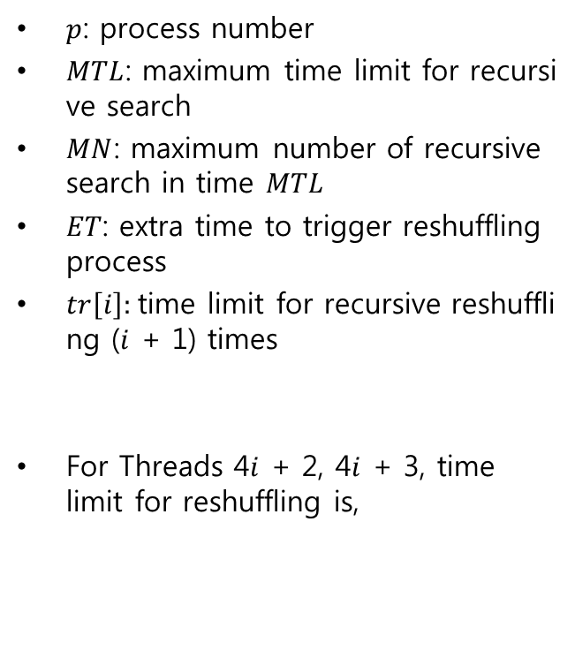
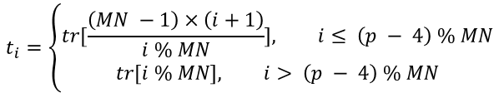

Recursive reshuffling
Diversify recursive time limit
$p$: process number
$MTL$: maximum time limit for recursive search
$MN$: maximum number of recursive search in time $MTL$
$ET$: extra time to trigger reshuffling process
$tr\left[i\right]:$time limit for recursive reshuffling ($i$ + 1) times
For Threads 4$i$+ 2, 4$i$+ 3, time limit for reshuffling is,
Time limit
Extra time to trigger stop
For parallel solver with N threads (N > MN)
Thread 0
Thread 1
Thread 2
Thread 3
Thread 4
$$tr\left[i\right] = \frac{MTL−\left(i+2\right)×ET }{i+2}$$
・・・
・・・
Thread MN
・・・
・・・
・・・
Thread K - 3
$$t_{i}=\left\{\begin{aligned}tr[\frac{\left(MN −1\right)×\left(i+1\right)}{i \% MN}], i≤ \left(p − 4\right) \% MN \\ &tr[i \% MN], i> \left(p − 4\right) \% MN\end{aligned}\right.$$
Thread K - 2
・・・
Thread K - 1
・・・
Thread K ~ N No time limit
Notes:
recursive reshufflingですが、threadごとにtime limitを置いて、再帰的にreshufflingを行います。
Reshufflingする周期に多様性を加え、繰り返しの数をバランスよくするようにしました。

Slide 76
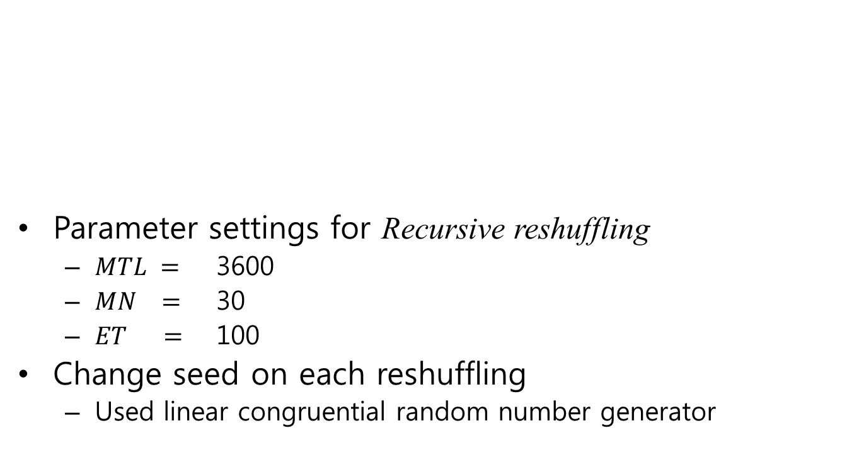
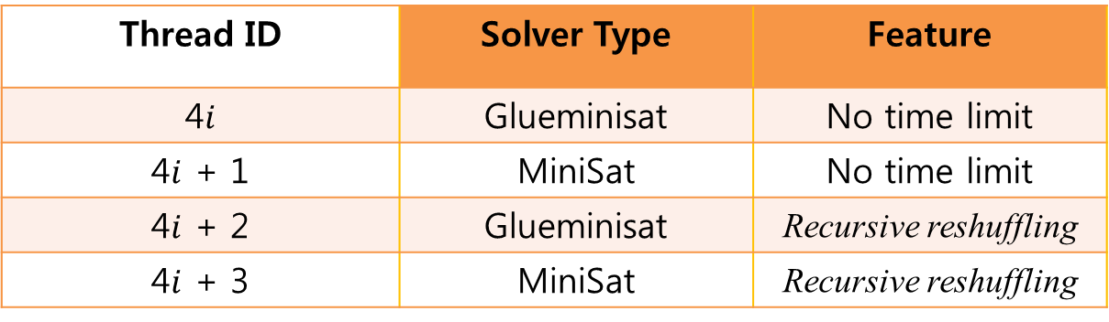
Parameter settings
Thread ID | Solver Type | Feature
4$i$ | Glueminisat | No time limit
4$i$+ 1 | MiniSat | No time limit
4$i$+ 2 | Glueminisat | Recursive reshuffling
4$i$+ 3 | MiniSat | Recursive reshuffling
Parameter settings for Recursive reshuffling
  $MTL =$ 3600
  $MN =$ 30
  $ET =$ 100
Change seed on each reshuffling
  Used linear congruential random number generator
Notes:
今回はこのようにパラメータセッティングをして、実験を行いました。
recursive reshufflingに対しては今回、任意的にこのような条件で実験を行いました。偶数のIDを持つthreadはGlueminisat、奇数のIDを持つthreadはMiniSatのfeatureを使います。また、mod 4で0、１になるIDを持つthreadはrecursive reshufflingを使わない、つまり時間制限なしで探索を行い、残りはrecursive reshufflingを使うようにしました。

Slide 77
Results in ParaGlueminisat
Benchmarks
  Set of 2 more fails by 12 ISoV test from SAT 2014 application 300 problems
  Time limit: 5000 sec
  Clause sharing policy
    Minisat: unit clauses
    Glueminisat: Clauses below LBD = 2
Solver Type | Solved / Problems
ParaGlueminisat + tie break | 37 / 49
ParaGlueminisat + ISoV | 39 / 49
ParaGlueminisat + use_minisat | 46 / 49
ParaGlueminisat + use_minisat + use_recursive | 41 / 49
Notes:
結果ですが、minisatとglueminisatを混ぜることでかなり結果はよくなりました。
しかし、残念ながら今回の実験ではrecursive reshufflingそんなにいい性能を見せてくれなかったです。
おそらく、並列の数が増えるとrecursive reshufflingが聴いてくるのではないかと
思っていますので、今後試したいと思っています。

Slide 78
Results summary
Solver Type | Solved / Problems
MiniSat 2.2 | 28 / 49
MiniSat 2.2 + ActivityMini_V0 | 33 / 49
MiniSat 2.2 + ActivityMini_V1 | 35 / 49
MiniSat 2.2 + ActivityMini_V2 | 28 / 49
Glueminisat | 31 / 49
Glueminisat + ActivityMini_V0 | 34 / 49
ParaGlueminisat + tie break | 37 / 49
ParaGlueminisat + ISoV | 39 / 49
ParaGlueminisat + use_minisat | 46 / 49
ParaGlueminisat + use_minisat + use_recursive | 41 / 49
Notes:
全体の結果をまとめるとこのような感じです。ActivityMiniを提案し、sequentialソルバのMinisat、Glueminisatに適用してみることで、ある程度いい結果を出すことができました。
並列ソルバで、ISoVを試し、この簡単な手法だけでもかなりの多様性が確保できることを確認しました。
さらに高速化のためのrecursive reshufflingを提案しましたが、今回はあまり良い結果は得られませんでした。

Slide 79
Future works
Clause sharing in parallel
  Dynamic limitation change policy is preferred
  Evaluation of quality of exchanged clauses
  How to apply these methods in massively parallel processing
Notes:
今後の予定です。今回、並列で学習クローズの共有をどうするかはあまりやってなくて、ただstaticなポリシーを入れるだけでした。しかし、staticなポリシーには、短所があります。探索状況によって共有しなくなったり、共有の頻度が多すぎる、少なすぎるなどの問題を起こる可能性があるため、動的にポリシーを変えたほうがもっといいかもしれません。
しかし、動的にポリシーを変更するためには、そのための評価が必要になり、トレードオフが発生します。さらに、これから並列の数はどんどん増えるはずなので、それに伴い、評価コストは幾何級数的に増加していきます。なので、極端にシンプルで低コストで評価できる方法を見つける必要があると思うので、こういうのを考慮した手法を考えていきたいです。
また、まだ全く手は出していませんが、超並列の場合はネットワークが入り、共有メモリでなくなるので、大きく手法が変わると思いますが、超並列の場合でも適用できるような汎用的な手法が提案できるように研究を進めていきたいと思っています。
例えば、互いに共有されたクローズがどれだけ役立ったのかの評価、あるいは、現在のLBDの分布を見て、平均が多い場合は、多くのクローズを削除して、他のthreadからのexportを積極的にするなど、いろいろ考えることができるので、動的な手法を考えていきたいと思います。
しかし、これから並列の数はどんどん増えるはずなので、極端にシンプルで低コストで評価できる方法を見つける必要があると思うので、こういうのを考慮した手法を考えていきたいです。
また、超並列の場合はネットワークが入り、共有メモリとは別のやり方になると思いますが、両方ともカバーできる汎用的な手法が提案できるかも考慮して研究を行う予定です。

Slide 80
To do
Preparation for JSAI 2015.05.30 ~ 2015.06.02
  Organized session 3
  : Theory, implement and application of SAT technology
Paper work for SAT conference 2015
  Dead line: 2015.04.29
Notes:
これからしばらくやるべきことですが、JSAIに投稿しましたので、5月末の発表に向けて準備をします。
また、2015年のSAT conferenceの原稿締め切りが4月待つまでなので、急いでこちのほうを作成するつもりです。
以上で発表終わります。

Slide 81
Verification of proposals
SAT solver solves a lot of areas
A solvers are strong for some instances, but very weak in others
SAT competition
  Contributing to impressive performance boot of SAT solver since 2002
Very strong for clique coloring problem
Proposal
?
Generally strong for other problems
Notes:
一般的に自分の提案手法をどうやって検証するかなんですが、例えば、SATソルバを改良して、Clique Coloring Problemが早く解けるようになったとしましょう。しかし、他の問題を解かせてみて全体的に性能が悪化していたら、SAT solverを作ったと言うよりはその専用のソルバを作ったことになります。
SAT solverはなるべく多くの問題をある程度効率よく解かせる汎用性を持つことに意義があるのではないかと思っています。
しかし、SATが適用される分野に広くて、汎用性を評価することは難しいところがあります。なので、1つの評価方法として、SAT competitionで評価していただくことが考えられます。
Competitionの方は様々な分野の問題が用意されていて、この業界ではベンチマークとしてよく用いられています。

Slide 84
Minisat [Een 03]
Most common SAT solver
  Containing many state-of-the-art techniques
  Winner of all application part on SAT competition 2005
  Base solver of may other solvers
  Code line: around 3000 lines
  Most recently released version: Minisat 2.2 (Base solver of Sequential, MiniSAT Hack, Application SAT+UNSAT track on sat competition 2014)
Notes:
Minisatなんですが、このソルバーは、多くの最新の要素技術を含めているソルバーで、2005年、Sat competitionのすべてのアプリケーション部門でトップの成績を上げたものです。
現在、多くのソルバーのベースになっています。
最近バージョンが2.2であり、2014年Sat competitionのMiniSAT Hack分野のベースソルバーになります。
MiniSAT HackというトラックはMiniSATをベースにして、1000文字以内の局所的な変化を加えて、性能を競うトラックです。

Slide 85
Comparison of parallel solvers
Solver Type | Solved (49 probs) | Solved (300 probs)
Plingeling ayv | 49 | 277
Plingeling ayv (guren) | 46 | ?
ParaGlueminisat (guren) | 46 | ?
cryptominisat-4.1-mt 4.1-mt | 45 | 243
CBPeneLoPe | 44 | 238
ParaCIRMiniSAT | 44 | 234
cryptominisat-4.1-mt-tuned-many 4.1-mt-tuned-many | 44 | 245
PeneLoPe | 43 | 248
Solver Type | Solved (49 probs) | Solved (300 probs)
Treengeling ayv | 42 | 248
CLaS (disqualified) | 38 | 245
glucose-syrup 1.0 | 38 | 247
Pcasso (disqualified) | 36 | 240
pglucose (disqualified) | 36 | 225
pmcSAT | 35 | 225
SatUZKp Build 55 | 24 | 178
SatUZKpl Build 55 Light | 23 | 172
Notes:
선형 합동 생성기

Slide 86
Unsolved problems in Sequential
ParaGlueminisat + use_minisat | Time (s)
002-23-96.cnf | 238
006-23-80.cnf | 4948
006-23-96.cnf | -
ctl_4291_567_5_unsat_pre.cnf | -

Slide 87
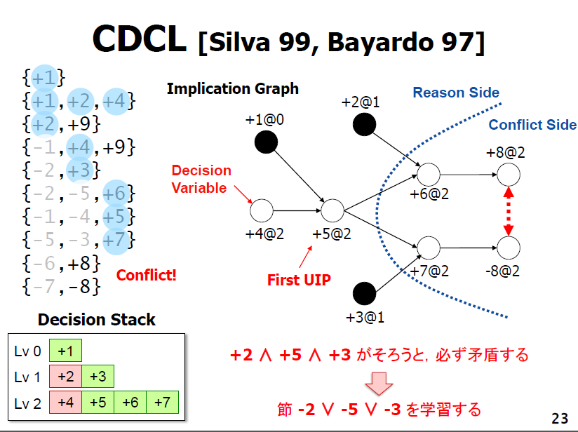

Slide 88
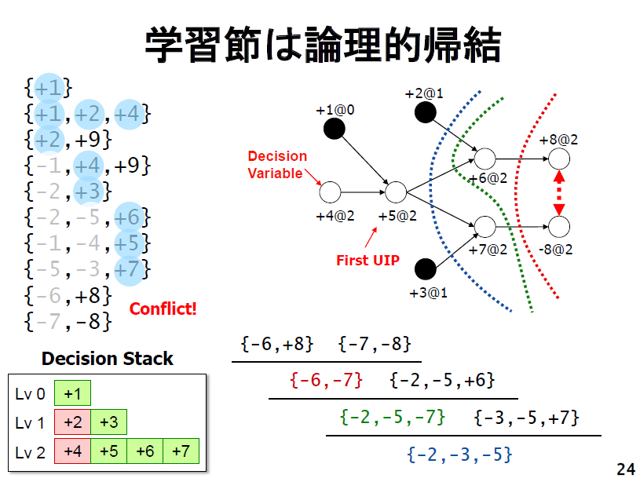

Slide 89
Experimental result (1/2)
Benchmarks
  Set of 2 more fails by 12 ISoV test from SAT 2014 application 300 problems
  Time limit: 5000 sec
Solver Type | Solved / Problems
Glueminisat | 31 / 49
Glueminisat + ActivityMini_V1 | 34 / 49
Notes:
LBDを用いるGlueminisatにActiviyMiniを一部のベンチマークで適用してみた結果、悪くなかった結果になりました。

